Slide 1


Full spectrum care,
for a full spectrum life.

Slide 2


An employee guide to your
Employee Assistance Service.

Slide 3

What do you have access to?
Employee Assistance Service (EAS)
Wellbeing Platform
and App.
Up to 6 counselling sessions where clinically appropriate.
A customised, digital platform delivering expert content on mental wellbeing, fitness and nutrition, in addition to a step counter and a calorie tracker.
For example, through the Platform, you will be able to access various Mental Health eLearning courses to educate, inform and empower you in various aspects of mental wellbeing.
Online CBT
Access to clinically led online Cognitive Behavioural Therapy pathways to expand access, drive engagement and increase recovery.

Slide 4

How do teachers, SNAs, and all school staff access the service?
Accessible 24/7, 365 days a year.
A completely free and
confidential service available via:
Freephone:
1800 411 057
WhatsApp:
Text ‘Hi’ to 087 369 0010
SMS
Text ‘Hi’ to 087 145 2056
(standard rates apply)
You can Live Chat or Request a Call Back on the wellbeing portal and phone app
Register Here: wellbeingtogether.spectrum.life/login
Organisation code: ylVIIU17

Slide 5

Will my employer know I have called?
Who can contact the EAS?
Do I need to use a code when I call?
The EAS service is a completely free & 100% confidential service. Your name and personal information will never be shared with your employer.
It is available to all employees, their partner or spouse and any dependents over the age of 16 years who are still living at home.
No. All that we require on the initial telephone is some basic information to confirm you are eligible to use the service

Slide 6

Who will you speak with on the initial telephone call?
Fully qualified and experienced counsellors, who can offer immediate telephone support.
Each case is handled by one of our counsellors who will become your dedicated Case Manager from start to finish.
On the initial call, the Case Manager will collect your details, discuss the issue you are facing and complete a quick assessment, taking approximately 30 minutes. This is also known as the triage process.
The Case Manager will then match the employee with the most appropriate service. This includes counselling, online CBT and recommendations to eLearning.

Slide 7

Short-Term Counselling:
How does it work?
Where appropriate, the person seeking support may be referred to counselling through the EAS following the triage process with the Case Manager.
When a person is referred to counselling, they will be provided with up to 6 sessions of counselling, where appropriate.
Our expansive team is spread throughout the Republic of Ireland, so a person may be matched with a counsellor within 30km of their home or workplace, where appropriate.
Our counsellors have a wide range of clinical specialities, meaning a person can be matched with someone experienced in dealing with their specific issue.
After being referred, a person’s appointment will be confirmed within 48 hours and scheduled within 5 days of initial contact.
Our team of counsellors speak more than 33 different languages. Therefore, we can deliver the counselling services in multiple languages.*

Slide 8

What if face-to-face, video, and telephone counselling are not possible?
There are a number of different options if face-to-face, video, or telephone counselling does not suit.
Our SMS, WhatsApp and live chat counselling services are fully secure, meeting the highest standard of sensitive data protection.
These services are highly convenient and easily accessible.
No matter the location, a person can be linked up with a counsellor who has clinical expertise in handling the person’s specific issue.

Slide 9
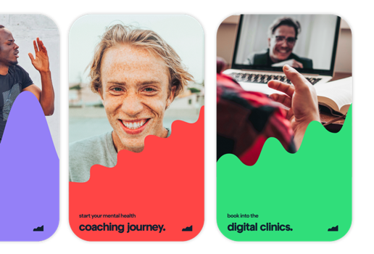
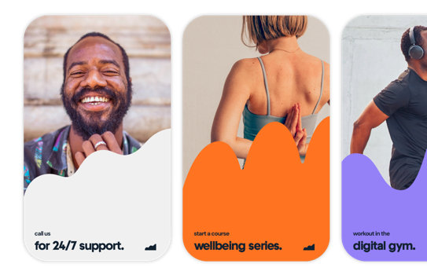
Your Wellbeing Platform and App!
What do you have access to?
Access the EAS directly through the wellbeing portal (desktop) and app (phone/tablet).
Freephone number, text and WhatsApp number, Live chat function, request a call back function.
Step and calorie counter.
Mental wellbeing, fitness and nutrition resources.
E-learning modules.
Informative blog articles on all aspects of wellbeing.
On demand webinars.
Book and attend wellbeing events.

Slide 10

Full spectrum care,
for a full spectrum life.

